Slide 1
MECM Admin role support

Slide 2
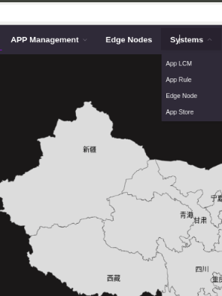
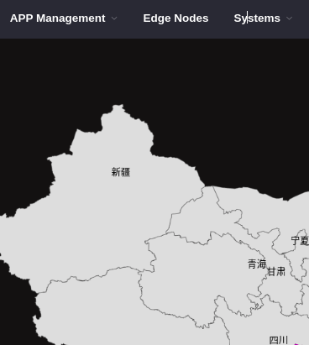
When logged in as Adminitrator, display systems along with available tenants so that admin can add/update configurations for tenants
When logged in as specific user, disable systems

Slide 3
Administrator operations
Administrator log-in as admin user.
Jwt token should contain role as ADMIN.
mecm-fe has to call Query API to display all the available tenants.
mecm-fe should allow administrator to configure (extSys reg. or perform application LCM operations) for selected tenant.
mecm-fe has to form mecm-be URL’s with the admin selected tenant ID for configuration (extSys reg. or app lcm operations or rules config).
mecm-be should provide all tenants configurations when query all entries api’s are done using admin user by ignoring tenant-id.

Slide 4
MECM Configuration API’s(Existing API’s)
Admin login
mecm-fe
?
appo
inventory
apm
Lcm Ctrl
Get all Tenants
Select tenant to perform operations
/inventory/v1/tenants/{tenant_id}/applcms
Configure applcm, host, app rule etc….
form inventory url with selected tenantID
preAuthorize request with role MECM_ADMIN is allowed
/apm/v1/tenants/{tenant_id}/packages
form apm url with selected tenantID
On-board application package
preAuthorize request with role MECM_ADMIN/MECM_TENANT is allowed
/appo/v1/tenants/{tenant_id}/app_instances/{app_instance_id}
form appo url with selected tenantID
Instantiate app
preAuthorize request with role MECM_ADMIN/MECM_TENANT is allowed
/inventory/v1/tenants/{tenant_id}/mechosts/{mechost_ip}/k8sconfig
form inventory url with selected tenantID
preAuthorize request with role MECM_ADMIN is allowed

Slide 5
MECM new Query all API’s (Existing API’s)
Admin login
mecm-fe
?
appo
inventory
apm
GET /inventory/v1/applcms
GET /inventory/v1/hosts
GET /inventory/v1/apprules
Query applcm, host, app rule etc….
preAuthorize request with role MECM_ADMIN allowed
Query application package
GET /apm/v1/tenants/packages
preAuthorize request with role MECM_ADMIN is allowed
Get app Inst info
GET /appo/v1/app_instance_infos
preAuthorize request with role MECM_ADMIN is allowed

Slide 6
MECM Query all API’s (Existing API’s)
Admin login
mecm-fe
?
appo
inventory
apm
Get all Tenants
Select tenant to perform operations
GET /inventory/v1/tenants/{tenant_id}/applcms
GET /inventory/v1/tenants/{tenant_id}/hosts
GET /inventory/v1/tenants/{tenant_id}/apprules
Query applcm, host, app rule etc….
preAuthorize request with role MECM_ADMIN/MECM_TENANT/MECM_GUEST allowed
Query application package
GET /apm/v1/tenants/{tenant_id}/packages
preAuthorize request with role MECM_ADMIN/MECM_TENANT/MECM_GUEST is allowed
Get app Inst info
GET /appo/v1/tenants/{tenant_id}/app_instance_infos
preAuthorize request with role MECM_ADMIN/MECM_TENANT/MECM_GUEST is allowed

Slide 7
MECM-FE design (TBD: yangyang)

Slide 8
THANK YOU

